Slide 1
Witness tests at CBTL during IQA in 2020
January, 2020 V 1.0
For questions or comments on the content, please contact Michael J. Howell or Kyle Huang

Slide 2
Agenda
Background
General
Witness Test under IEC 60335-1 (Household and similar electrical appliances) or IEC 60950-1 (Information technology equipment)
Witness Test under IEC 60745-2-5 (Hand-held motor-operated electric tools – Particular requirements for circular saws)
Witness Test under IEC 60601-1 (Medical electrical equipment)
Witness Test under IEC 60598-1 (Luminaires)
Witness Test under IEC 62368-1 (Audio/video, information and communication technology equipment)
Calibration Certificate Review (TOOL - Test Probe; OFF/ITAV - High Voltage Oscilloscope Probes)
Records of Audit (lab assessment form example)

Slide 3
Background
Lab test capability is part of an IECEE CBTL Assessment. Some CARs generated from IECEE CBTL assessments focused on lab test capability, specifically equipment, critical consumables, or test methods not in compliance with the IEC standard requirements.
Though some UL standards for final products have been harmonized with IEC standards, they still have differences in small details, due to the structure of IEC standards, CTL Decision Sheets published by IECEE CB Scheme, IEC TC Interpretation Sheets and the traditional approach of UL that includes the use of Certification Requirement Decisions and PAGs developed by UL PDE’s.
Note: IEC TC Interpretation Sheets: https://decisions.iecee.org/iecee/SearchCMC.nsf/de_h.xsp?v=ctl#

Slide 4
General
Following tests are selected by CB Scheme program owner for witness of test in 2020.
1) Test under IEC 60335-1 (or IEC 60950-1, if IEC 60335-1 is not in CBTL scope)
- Resistance to heat and fire (a.k.a, “Ball Pressure Test”)
2) Test under IEC 60745-2-5
- Mechanical hazards (using test probes)
3) Test under IEC 60601-1
- ME EQUIPMENT intended to be connected to a power source by a plug
4) Test under IEC 60598-1
- Tumbling barrel test
5) Test under IEC 62368-1
- Backfeed safeguard in battery backed up supplies
If a CBTL has capability in several above standards, all tests applicable need to be witnessed.

Slide 5
General
Additionally, the following specific calibration certificates are selected by CB Scheme program owner for review in 2020:
6) TOOL – Mechanical Test Probe (IEC 62841-1)
7) OFF/ITAV – Stand-Alone High Voltage Oscilloscope Probes (IEC 62368-1 and IEC 60950-1)
If a CBTL has capability in standards noted in 6) and 7), check for a sample of each of the applicable equipment calibration certificates noted. However, only one sample of each equipment type needs to be checked if the lab has multiple such assets (e.g., if the lab has ten such Mechanical Test Probes, just sample a calibration certificate for one).
Please also note that labs may have equipment specifically calibrated to meet the IEC requirements, with other equipment just meeting UL requirements – if this is the case, ask lab how they are able to identify those suitable for CB Scheme testing.

Slide 6
General
Corporate Internal Quality Audits will focus on lab testing capability during on-site audits of UL labs based on their existing CBTL scopes.
A group of tests selected will be reviewed by IQA auditors. Nonconformance will be documented in the GCAR Database. The list of tests assessed will be included in the audit records.
The corrective action will be handled according to the Global Corrective Action Procedure. If a systemic issue is found, the corrective action may be escalated for effective resolution across UL.
Principal Quality Engineer will maintain a list of tests selected in an ongoing CBTL Audit Plan. There is no intent to cover every test in every standard. However, assessments will cover various types of testing activities under CBTL scopes in a period of time obtained from program management and NCB inputs.

Slide 7
General
The list of tests need to be included in Attachment A of the Scope letter and communicated to local contact before the audit so the site can arrange the resource for the audit.

Slide 8
1) Resistance to heat and fire
IEC 60335-1:2010+AMD1:2013+AMD2:2016, Clause 30.1
CTL Equipment list:
https://www.iecee.org/get_fileID.php?file_id=717723
Test Ambient Conditions:
(As specified by the test methods indicated)

Slide 9
1) Resistance to heat and fire
Test Method:
30.1 External parts of non-metallic material, parts of insulating material supporting live parts including connections, and parts of thermoplastic material providing supplementary insulation or reinforced insulation, shall be sufficiently resistant to heat if their deterioration could cause the appliance to fail to comply with this standard.
This requirement does not apply to the insulation or sheath of flexible cords or internal wiring.
Compliance is checked by subjecting the relevant part to the ball pressure test of IEC 60695-10-2.

Slide 10
1) Resistance to heat and fire
Test Method (cont.):
The test is carried out at a temperature of 40 °C ± 2 °C plus the maximum temperature rise determined during the test of Clause 11 (This is the Heating test, do not audit), but it shall be at least
75 °C ± 2 °C, for external parts; (parts such as enclosures)
125 °C ± 2 °C, for parts supporting live parts. (parts such as connectors)
However, for parts of thermoplastic material providing supplementary insulation or reinforced insulation (parts such as a transformer bobbin), the test is carried out at a temperature of 25 °C ± 2 °C plus the maximum temperature rise determined during the tests of Clause 19 (This is the Abnormal operation test, do not audit), if this is higher. The temperature rises obtained during the test of 19.4 are not taken into account provided that the test is terminated by the operation of a non-self-resetting protective device and it is necessary to remove a cover or use a tool to reset it.

Slide 11
1) Resistance to heat and fire
Test Method (cont.):
NOTE 1 For coil formers, only those parts that support or retain terminals in position are subjected to the test.
NOTE 2 The test is not carried out on parts of ceramic material.
NOTE 3 The selection and sequence of tests for resistance to heat are shown in Figure O.1.

Slide 12
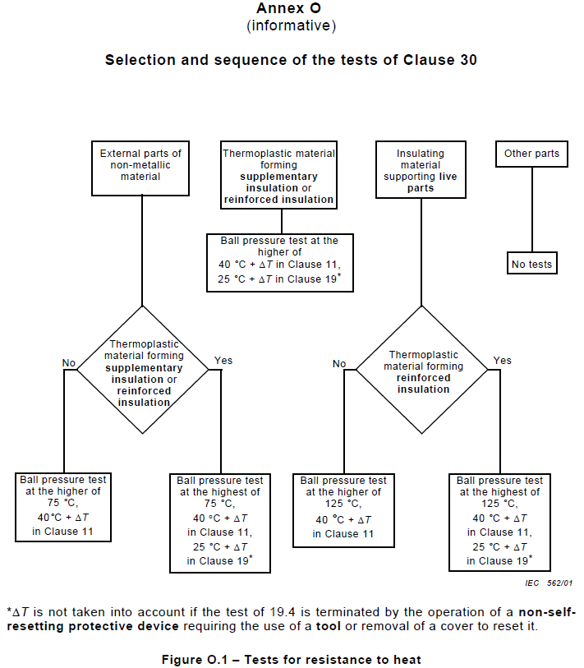
1) Resistance to heat and fire

Slide 13
1) Resistance to heat and fire
From IEC 60695-10-2:2014
5 Apparatus
5.1 Loading device
The loading device shall consist of a 5 mm ± 0,05 mm diameter pressure ball (a finished steel ball for rolling bearings in accordance with ISO 3290-1) attached to a system of weights designed to apply a downward force equivalent to a 20 N ± 0,2 N load including the mass of the pressure ball.
An example of a typical loading device is shown in Figure 1.

Slide 14
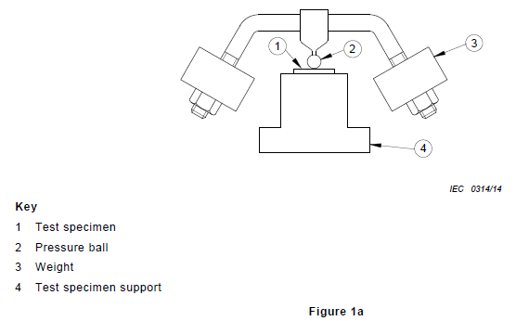
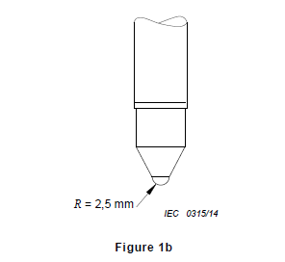
1) Resistance to heat and fire
From IEC 60695-10-2:2014 (continued):

Slide 15
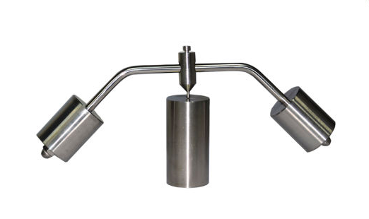
1) Resistance to heat and fire

Slide 16
1) Resistance to heat and fire
From IEC 60695-10-2:2014 (continued):
5.2 Test specimen support
The test specimen support shall be such that
a) it rigidly supports the test specimen in a horizontal position;
b) it has sufficient strength to support the loading device;
c) it has a smooth flat surface;
d) it has sufficiently large mass to prevent a significant reduction in temperature of the apparatus during the installation and removal of the test specimen from the heating oven.
NOTE It has been found useful to mount a separate thermocouple in the centre of the test specimen support approximately 3 mm below the surface to check that the temperature of the test specimen support does not significantly deviate from the test temperature. (see also Slide 19 for CTL Decision details)

Slide 17
1) Resistance to heat and fire
From IEC 60695-10-2:2014 (continued):
5.3 Heating oven
The heating oven shall be a single chamber type in accordance with IEC 60216-4-1 with regard to temperature differences, fluctuation, and variations appropriate to the test temperature (See Slides 31-34) .
In addition, the heating oven shall be capable of returning to the set temperature in accordance with the requirements in 8.3 after the heating oven door is closed after inserting the test specimen.
Additionally per CTL Decision DSH 2075:
“For the purpose of ball pressure testing, chambers with or without forced convection may be used, provided all other requirements are fulfilled.”

Slide 18
1) Resistance to heat and fire
From IEC 60695-10-2:2014 (continued):
5.4 Optical measuring instrument
The optical measuring instrument shall have an optical magnification of at least 10⋅ and shall incorporate a calibrated reticule or cross-travel measuring table with a resolution of not more than 0,1 mm. A lighting device can be used to illuminate the surface where the pressure ball was applied.
5.5 Temperature measuring equipment
The temperature shall be measured using equipment with a accuracy of ± 2 K below 100 °C and ± 3 % at 100 °C and above. It is preferable to measure the temperature by a thermocouple type K or J inserted in the test specimen support. (see also next Slide regarding CTL Decision details)

Slide 19
1) Resistance to heat and fire
Additional CTL Decision requirements regarding temperature measurement location:
Per CTL Decision DSH 372, for tests on enclosure samples:
“The temperature should always be measured at the hottest accessible spot, which is usually on the inside of the enclosure.” (for heating test, do not audit)
Per CTL Decision DSH 0391D:
“Following clause 5.2 of the standard and considering the note there, a separate thermocouple on or right below the surface of the test specimen support and as close as practical to the test sample shall be used to check that the temperature of the test specimen support does not significantly deviate from the test temperature.
In addition measure the air temperature as close as possible to the test specimen.”
(There should be at least two thermocouples placed: one on the test specimen support and one in the air adjacent to the test specimen.)

Slide 20
1) Resistance to heat and fire
From IEC 60695-10-2:2014 (continued):
6 Test specimens
6.1 End product test method
A test specimen is cut from the end product in such a way that a piece at least 2,5 mm thick with approximately parallel upper and lower surfaces is obtained. If necessary, the thickness may be attained by stacking two or more sections so long as there is no noticeable movement between the surfaces prior to testing. If it is not possible to cut a test specimen with parallel surfaces, care shall be taken to support the area of the test specimen directly under the pressure ball. The test specimen shall be a square with a minimum of 10 mm sides or a circle with a diameter of at least 10 mm.
If it is impracticable to use a test specimen from the end product, then a plaque of identical material may be used as the test specimen as described in 6.2 (see next Slide).
NOTE Three test specimens may be necessary.

Slide 21
1) Resistance to heat and fire
From IEC 60695-10-2:2014 (continued):
6.2 Material Test method
6.2.1 Test specimen preparation
(Sample fabrication requirement, no need to verify during audit)
6.2.2 Test specimen dimensions
The dimensions of the planar sections of the test specimens shall be at least 10 mm in length and 10 mm in width, or a circle with a diameter of at least 10 mm and shall be provided in a thickness of 3,0 mm ± 0,5 mm.
NOTE 15 test specimens may be necessary.
(For the purposes of this audit demonstration, it is not necessary to have the exact test specimens dimensions as noted in 6.2.1 or 6.2.2 However, verify that the dimensions are checked by calipers as part of the test.)

Slide 22
1) Resistance to heat and fire
From IEC 60695-10-2:2014 (continued):
7 Conditioning
The test specimen shall be stored for at least 24 h in an atmosphere having a temperature between 15 °C and 35 °C and a relative humidity between 45 % and 75 %.
NOTE For materials, the mechanical characteristics of which are significantly affected by moisture content or temperature, a more precise conditioning may be specified.
(As part of the audit preparation, please make arrangements with the lab to perform this conditioning prior to the remaining test demonstration.)

Slide 23
1) Resistance to heat and fire
From IEC 60695-10-2:2014 (continued):
8.1 Selection of the test temperature
8.1.1 Method A − End product test method
(Follow method from IEC 60335-1)
8.2 Heating oven and test apparatus setup
Conduct the test method in air, in a heating oven (see 5.3) at a temperature specified in the relevant specification (within a tolerance of ± 2 °C) measured within 50 mm of the approximate centre of the test specimen. The test specimen support and loading device shall be preheated at the test temperature for a minimum of 3 h.

Slide 24
1) Resistance to heat and fire
From IEC 60695-10-2:2014 (continued):
8.3 Test setup
Place the test specimen in the approximate centre of the test specimen support ensuring that its upper surface is horizontal. Gently lower the pressure ball of the loading device on to the approximate centre of the test specimen. Ensure that no conditions exist that will cause the pressure ball to move other than in a downward direction during the test method.
The installation of the test specimen shall be performed in as short a time as practicable, but not exceeding 30 s. The test chamber shall return to the specified temperature (± 2 °C) within 5 min and without any overshoot exceeding 5 °C.
The loading device shall remain on the test specimen for a period of 60 min
min.

Slide 25
1) Resistance to heat and fire
From IEC 60695-10-2:2014 (continued):
8.4 Test specimen post conditioning
After removal of the loading device;
a) the test specimen shall be placed into water at 20 °C ± 5 °C (at the time of immersion) within 10 seconds, then
b) the test specimen shall remain immersed in the water for 6 min ± 2 min, then after removal from the water, remove all visible traces of water and measure dimension d as described in Figure 2 within 3 min.

Slide 26
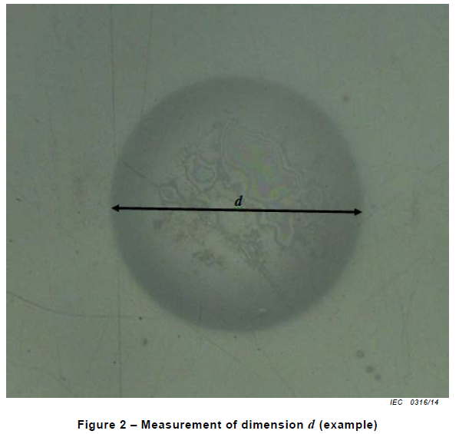
1) Resistance to heat and fire
From IEC 60695-10-2:2014 (continued):

Slide 27
1) Resistance to heat and fire
From IEC 60695-10-2:2014 (continued):
8.5 Measurements
Dimension d is the largest distance that can be measured across the indentation from one clearly defined edge of the indentation to another. Dimension d shall exclude any upward deformation.
In case of dispute with regard to Method A (End product test method), make two further tests on two other test specimens, both of which shall meet the pass requirement of Clause 9. When additional tests are being conducted in the same heating oven at the same temperature, the heating oven and test apparatus preconditioning noted in 8.2 may be waived and the testing initiated as soon as the heating oven temperature stabilizes. (consider to ask how they would document these scenarios in the datasheet record)

Slide 28
1) Resistance to heat and fire
From IEC 60695-10-2:2014 (continued):
NOTE 1 An indentation which is not circular may indicate non-level conditions, movement of the apparatus or test specimen, a non-homogeneous material such as glass-reinforced plastics, or external vibrations in the vicinity of the heating oven. (see also next Slide regarding CTL Decision clarification)
NOTE 2 In case of dispute regarding the value of d, the test specimen may be subjected to cross-sectioning (see Figure 2).
NOTE 3 To assist in the measurement of the diameter d by clarifying the edges of the indentation, it has been practical to colour the surface of the specimen in a contrast colour after the test whereby the indentation edge appears more distinctly.

Slide 29
1) Resistance to heat and fire
From IEC 60695-10-2:2014 (continued):
9 Evaluation of test results
The result is presented as a pass if dimension d does not exceed 2,0 mm.
Additionally per CTL Decision DSH 2075:
“In case of non-round indentations obtained, the maximum difference between the longest and shortest measurement should not exceed 0,2 mm. In cases where > 0,2 mm difference between diameters is observed, the test shall be repeated. Where a large difference in diameters continues to be observed, the non-round nature of the indentation shall be reported with the result.”

Slide 30
1) Resistance to heat and fire
Equipment:
Check the calibration records:
Temperature DAQ (± 2 K below 100 °C and ± 3 % at 100 °C and
above )
Optical measuring instrument of at least optical magnification 10× (resolution of not more than 0,1 mm) (up to 1 mm: ± 0,05 mm; 1 mm up to 25 mm: ± 0,1 mm)
Timer (1 s and above: ± 1% )
Calipers ( 1 mm up to 25 mm: ± 0,1 mm )
Ambient Temperature Indicator ( +/- 2 degree C)
B. Check calibration or verification records:
Ball Pressure Apparatus - meeting Figure 1 ( 20 N ± 0,2 N downward force; 5 mm ± 0,05 mm diameter pressure ball )
Thermocouples ( Type K or J )
Heating Oven to IEC 60216-4-1 ( see next four Slides )

Slide 31
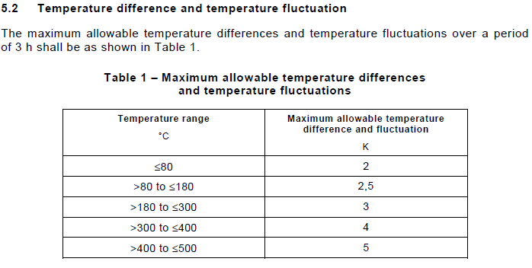
1) Resistance to heat and fire
As derived from IEC 60216-4-1:2006:
(The temperature range applicable for this test will most likely be >80 to ≤180°C)

Slide 32
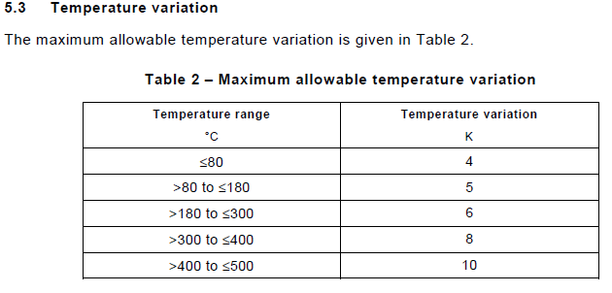
1) Resistance to heat and fire
As derived from IEC 60216-4-1:2006 (cont.):
(As previous, the temperature range applicable for this test will most likely be >80 to ≤180°C)

Slide 33
1) Resistance to heat and fire
As derived from IEC 60216-4-1:2006 (cont.):
(If not already calibrated to IEC 60216-4-1:2006, check that any oven verification records cover the method below.)
From 6.3.1:
“For the determination of temperature difference and temperature fluctuation, place a series of temperature sensors (maximum time constant 30 s) in the oven chamber under investigation, ensuring that:
– one sensor is located within 25 mm of the centre of the chamber;
– one additional sensor is located (50 ± 10) mm distance from the walls in each of the eight corners of the chamber.
The length of wire connecting the temperature sensors to the indicating system shall be chosen such that the indicated temperature is not influenced by thermal conduction from the oven. Externally the wires shall be thermally insulated and maintained in essentially draught free conditions.
Set the level of ventilation at the manufacturer's stated minimum.
Allow the temperature of the chamber to stabilize.
Measure and record the temperature of the individual sensors to 0,1 K a sufficient number of times over a period of approximately 3 h to allow identification of any cyclic behavior and permit determination of the maximum, minimum and mean temperatures of each temperature sensor over the measuring period.”

Slide 34
1) Resistance to heat and fire
As derived from IEC 60216-4-1:2006 (cont.):
Some definitions:
3.2 exposure volume
that central part of the exposure chamber that meets the requirements for temperature fluctuation, temperature difference and temperature variation
3.3 exposure temperature T
temperature selected for ageing test specimens to obtain data for the determination of effects of temperature
3.4 temperature fluctuation δT1
maximum change in temperature at one point in the exposure volume over a period of time
3.5 temperature difference δT2
maximum difference of temperature between any two points in the exposure volume at any one time
3.6 temperature variation δTv
difference between the highest temperature and the lowest temperature measured in the exposure volume over a period of time

Slide 35
1) Resistance to heat and fire
**Validate the following method only if the CBTL does not have IEC 60335-1 in the scope**
IEC 60950-1:2005+A1:2009+A2:2013, Clause 4.5.5
CTL Equipment list:
https://www.iecee.org/get_fileID.php?file_id=181070
Test Ambient Conditions:
As specified by the test methods indicated

Slide 36
1) Resistance to heat and fire
Test Method:
4.5.5 Resistance to abnormal heat
Thermoplastic parts on which parts at HAZARDOUS VOLTAGE are directly mounted shall be resistant to abnormal heat.
Compliance is checked by subjecting the part to the ball pressure test according to IEC 60695-10-2. The test is not made if it is clear from examination of the physical characteristics of the material that it will meet the requirements of this test.
The test is made in a heating cabinet at a temperature of (T – Tamb + Tma + 15 °C) ± 2 °C. (This information is derived from the Temperature test, do not audit)
However, a thermoplastic part supporting parts in a PRIMARY CIRCUIT is tested at a minimum of 125 °C. (on such parts as bobbins and connectors)
The significances of T, Tma and Tamb are as given in 1.4.12.1. (see next Slide)

Slide 37
1) Resistance to heat and fire
Per 1.4.12.1:
T is the temperature of the given part measured under the prescribed test conditions;
Tamb is the ambient temperature during test;
Tma is the maximum ambient temperature permitted by the manufacturer's specification, or 25 °C, whichever is greater.
**************
(The same test methods and equipment requirements from IEC 60695-10-2 apply at this point.)

Slide 38
1) Resistance to heat and fire
CTL Decisions
The following CTL Decisions apply generally for Ball Pressure testing per IEC 60695-10-2:2014. Ask staff about their awareness of these decisions, the location on the IECEE website, and their high level understanding:
DSH 2075
DSH 0391D
DSH 372

Slide 39
2) Mechanical hazards (using test probes)
IEC 60745-2-5:2010, Clause 19
CTL Equipment list:
https://www.iecee.org/get_fileID.php?file_id=172898
Test Ambient Conditions:
From the base standard IEC 60745-1:2006:
5.6 The tests are made in a draught-free location and, in general, at an ambient temperature of (20 ± 5) °C.
(Ask test staff about applicability of recording ambient conditions for mechanical testing)

Slide 40
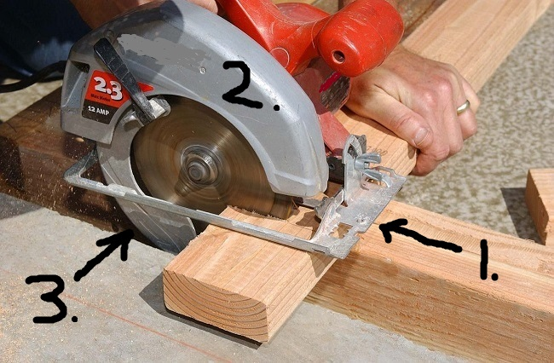
2) Mechanical hazards (using test probes)
1. Base Plate, 2. Upper Guard, 3. Lower Guard

Slide 41
2) Mechanical hazards (using test probes)
Note – The test will likely be conducted by L2 project evaluation staff as part of the construction review, rather than by an L1 lab technician. Equipment and results will mostly likely be recorded directly in a TRF and/or CRD (if Canadian Certification Scheme is involved) rather than traditional datasheet.

Slide 42
2) High impact resistant glass test
2) Mechanical hazards (using test probes)
Test Methods:
19.101 Guarding above the base plate
19.101.1 The blade above the base plate shall be guarded by the upper guard.
Compliance is checked by inspection.
19.101.2 Apertures in the guarding system above the base plate, unless otherwise specified in 19.101.2.1 to 19.101.2.4, shall be designed to prevent contact with the cutting edge zone of any specified blade. (For purposes of demonstration, assume not otherwise specified per 19.101.2.1 to 19.101.2.4)
Compliance is checked with the test probe ‘a' of Figure 105, which is inserted at any angle and to the depth possible. The test is performed with the saw set for 90° and maximum depth of cut.

Slide 43
2) Mechanical hazards (using test probes)
Test Methods (cont.):
19.101.2.2 The perpendicular projection of the upper guard on to the blade shall cover at least the smallest specified blade-cutting edge zone. The space between the upper guard and the blade shall be designed to prevent contact with the saw blade teeth tips of the specified blade.
Compliance is checked with the test probe 'a' of Figure 105, which is inserted at any angle and to the depth possible, as illustrated in Figure 106. The test is performed with the saw set for 90° and maximum depth of cut.

Slide 44
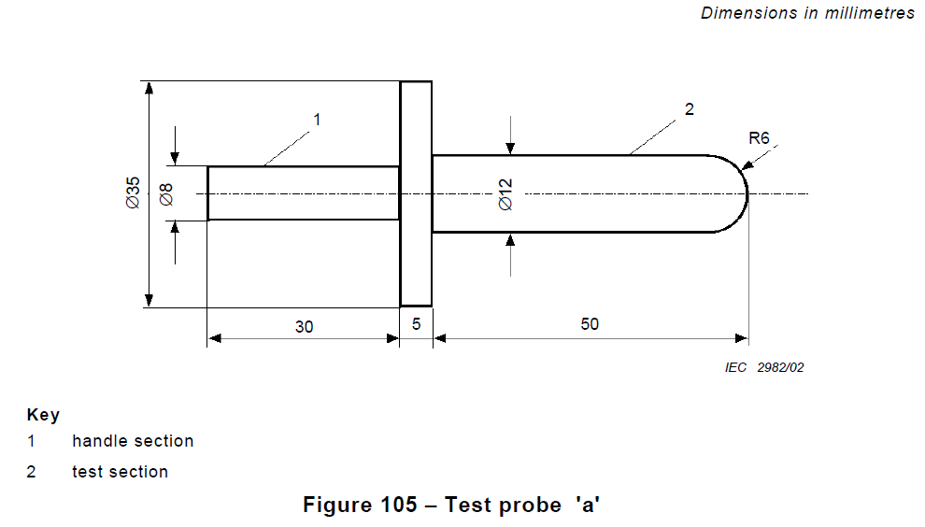
2) High impact resistant glass test
2) Mechanical hazards (using test probes)

Slide 45
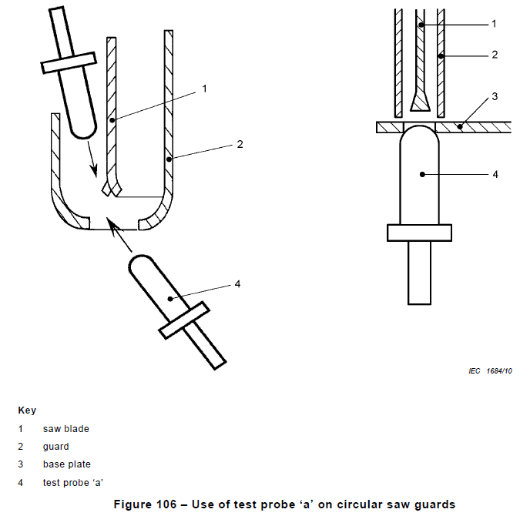
2) Mechanical hazards (using test probes)

Slide 46
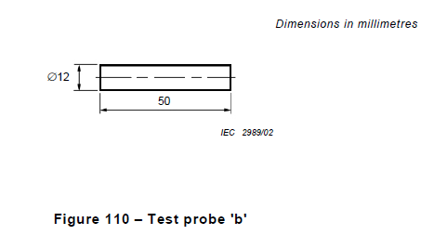
2) Mechanical hazards (using test probes)
Test Methods (cont.):
19.101.2.4 The cutting edge zone of the blade above the base plate shall not be accessible from the front of the saw.
Compliance is checked with the rigid test probe 'b' of Figure 110 which shall not contact the blade when the saw is set for a 90° cut and any depth of cut and the probe 'b' is centred with the blade then advanced in any single plane perpendicular to the blade and parallel to the base plate, as illustrated in Figure 111. The test is repeated with probe 'b' offset 13 mm to the right of the blade centre and then offset 13 mm to the left of the blade centre.

Slide 47
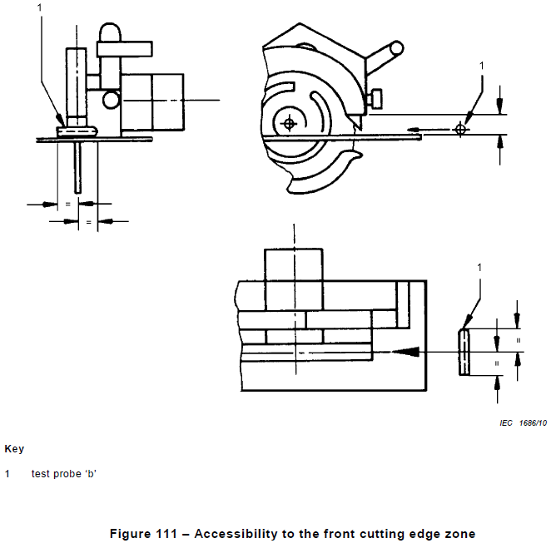
2) Mechanical hazards (using test probes)

Slide 48
2) Mechanical hazards (using test probes)
Test Methods (cont.):
19.102.5 For saws using a guarding system as shown in Figures 102 and 103 equipped with a riving knife, the lower guard of which needs to allow for the passage of the blade, riving knife and its holder, the apertures in the lower guard shall be kept as small as possible.
Compliance is checked with the test probe 'a' of Figure 105 when inserted at any angle and to the depth possible as illustrated in Figure 106. It shall not be able to contact the cutting edge zone of the largest specified blade.

Slide 49
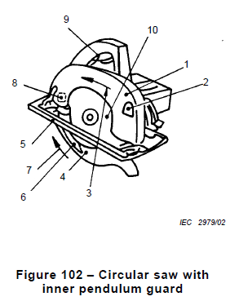
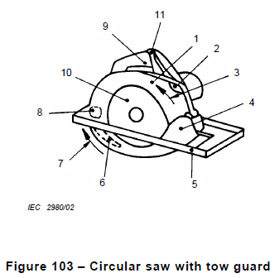
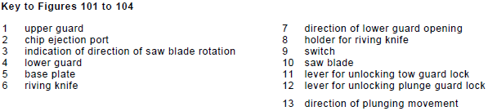
2) Mechanical hazards (using test probes)

Slide 50
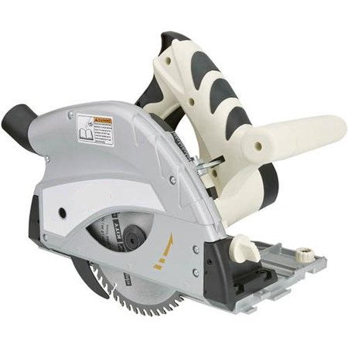
2) Mechanical hazards (using test probes)
Example hand-held saw with riving knife shown (plunge type saw, no lower cover)

Slide 51
2) Mechanical hazards (using test probes)
Some definitions:
3.102
cutting edge zone
the outer 20 % of the blade’s radius

Slide 52
2) Mechanical hazards (using test probes)
Equipment:
Check the calibration records:
Ambient Temperature Indicator ( +/- 2 degree C )
Inclinometer / Protractor ( ± 1 degree )
Calipers ( 1 mm up to 25 mm: ± 0,1 mm )
B. Check calibration or verification records:
Test probe 'a' of Figure 105 (up to 1 mm: ± 0,05 mm; 1 mm up to 25 mm: ± 0,1 mm)
Rigid test probe 'b' of Figure 110 (up to 1 mm: ± 0,05 mm; 1 mm up to 25 mm: ± 0,1 mm)

Slide 53
3) ME EQUIPMENT intended to be connected to a power source by a plug
IEC 60601-1:2005+A1:2012, Clause 8.4.3
CTL Equipment list:
https://www.iecee.org/get_fileID.php?file_id=269652
Test Ambient Conditions:
The standard does not specify test ambient conditions, but indicates that tests are performed within the range of environmental conditions indicated in the technical description (users manual, etc). (Ambient temperature, humidity and atmospheric pressure should be monitored and recorded during the test.)

Slide 54
3) ME EQUIPMENT intended to be connected to a power source by a plug
Test Method:
8.4.3 * ME EQUIPMENT intended to be connected to a power source by a plug
ME EQUIPMENT or its parts intended to be connected to a power source by means of a plug shall be so designed that 1 s after disconnection of the plug the voltage between the pins of the plug and between either supply pin and the ENCLOSURE does not exceed 60 V or, if this value is exceeded, the stored charge does not exceed 45 μC.

Slide 55
3) ME EQUIPMENT intended to be connected to a power source by a plug
Compliance is checked by the following test:
ME EQUIPMENT is operated at RATED voltage or at the upper limit of the RATED voltage range.
ME EQUIPMENT is disconnected from the power source with any relevant switch in the “On” and Off” positions.
Either the ME EQUIPMENT is disconnected from the power source by means of the plug, in which case the test is performed as many times as necessary to allow the worst case to be measured, or a triggering circuit is used to ensure that disconnection occurs at the peak of the supply voltage waveform.

Slide 56
3) ME EQUIPMENT intended to be connected to a power source by a plug
The voltage between the pins of the plug and between any pin and the ENCLOSURE is measured 1 s after disconnection with an instrument the internal impedance of which does not affect the test significantly.
NOTE An example of a measuring arrangement that is considered acceptable is an oscilloscope and probe having an input impedance consisting of a resistance of 100 MΩ ± 5 MΩ in parallel with an input capacitance of 20 pF ± 5 pF.
The stored charge can be measured or calculated by any convenient method.
Where appropriate, a d.c. input voltage equal to the peak of the RATED SUPPLY MAINS voltage may be used.

Slide 57
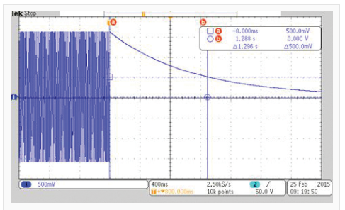
3) ME EQUIPMENT intended to be connected to a power source by a plug
Example of disconnection at peak of the supply voltage waveform:

Slide 58
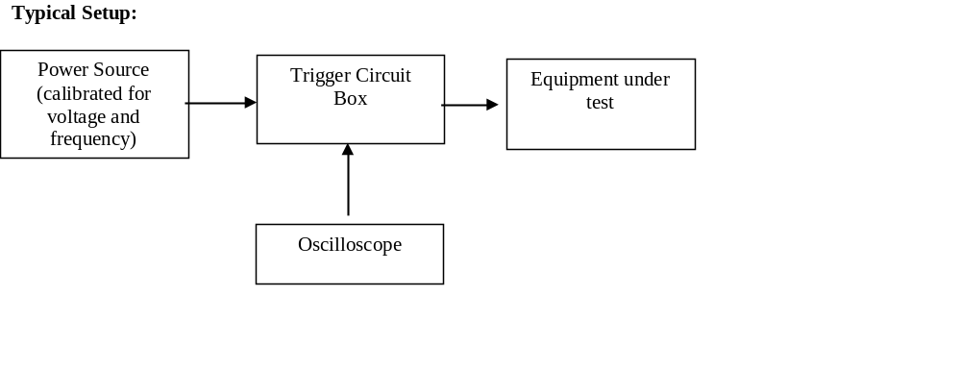
3) ME EQUIPMENT intended to be connected to a power source by a plug
Additional Notes:
Q = V*C,
where Q (charge) is measured in Coulombs, V in volts, and C (capacitance) in Farads.
Measurements to “ENCLOSURE” may be either to Protective Earth (ground pin connection) for Class I equipment, or to metal foil on enclosure for Class II equipment. (Class I equipment will utilizes a three-prong plug connection, whereas Class II will utilize a two-prong plug connection).

Slide 59
3) ME EQUIPMENT intended to be connected to a power source by a plug
Equipment:
Check the calibration records:
Ambient Temperature Indicator ( +/- 2 degree C )
Ambient Humidity Meter ( +/- 6% )
Barometer ( +/- 10 kPa) – Other means of measurement are allowed, if the traceability to national calibration standards is provided.
Voltage Probe to Oscilloscope – Verify high impedance probe used ( 100 MΩ ± 5 MΩ ) ( If calibrated as part of Oscilloscope, Voltage up to 1000 V, up to 1 kHz: ± 1.5% ) ( If calibrated stand-alone, see Slides 83 and 84 )
Oscilloscope ( Voltage up to 1000 V, up to 1 kHz: ± 1.5% )
RCL Meter ( check calibration for capacitance; no accuracy specified )
Power Supply ( Voltage up to 1000 V, up to 1 kHz: ± 1.5%; Frequency: ± 0.2% )
B. Check validation records:
Triggering Circuit

Slide 60
4) Tumbling barrel test
IEC 60598-1:2014+AMD1:2017, Clause 4.13.6
CTL Equipment list:
https://www.iecee.org/get_fileID.php?file_id=454091
Test Ambient Conditions:
0.4.2 Except where otherwise specified in the sections of Part 1 or Part 2, luminaires shall be tested as delivered, and installed as for normal use, in an ambient temperature of between 10 °C and 30 °C, having regard to the manufacturer's installation instructions.

Slide 61
4) Tumbling barrel test
Test Method:
4.13.6 Plug-ballast/transformers and mains socket-outlet-mounted luminaires shall have adequate mechanical strength.
Compliance is checked by the following test, which is made in a tumbling barrel as shown in Figure 25.
The barrel is turned at a rate of five revolutions per minute, ten falls per minute thus taking place. (may involve software validation)
The sample falls from a height of 50 cm onto a steel plate 3 mm thick, the number of falls being:
– 50 if the mass of the sample does not exceed 250 g;
– 25 if the mass of the sample exceeds 250 g.

Slide 62
4) Tumbling barrel test
Test Method (cont.):
After the test, the sample shall show no damage within the sense of this standard, but it need not be operative and any damage to the glass bulb shall be ignored. Provided that the protection against electric shock is not affected, small pieces which may have broken off the sample are ignored.
Distortion of pins and damage to the finish and small dents which do not reduce the creepage distances or clearances below the values specified in Section 11 are ignored. (Verify verbally as included as part of the test method, but do not audit the details regarding measurement of clearance or creepage distances)

Slide 63
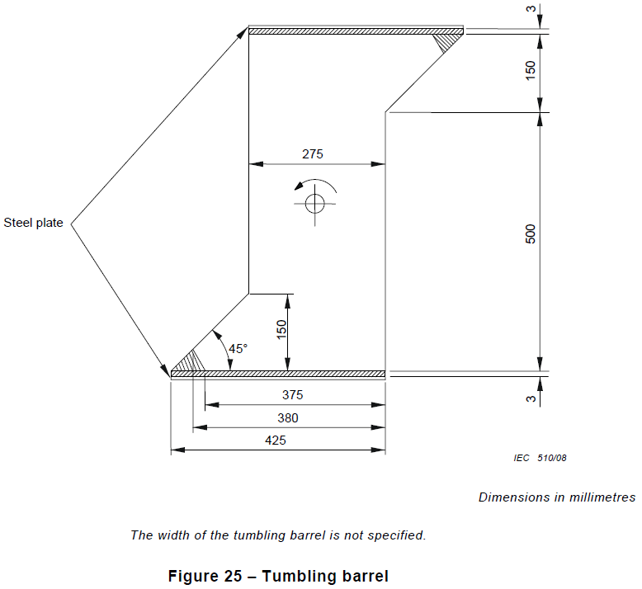
4) Tumbling barrel test

Slide 64
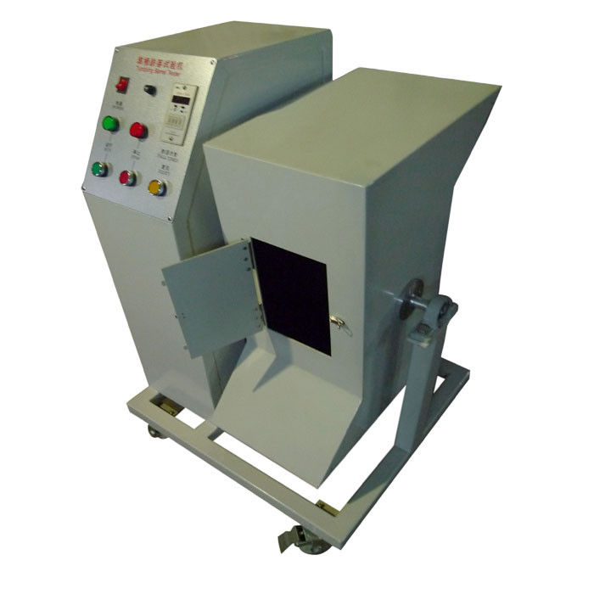
4) Tumbling barrel test
https://www.youtube.com/watch?v=TjrmdLhgP1o

Slide 65
4) Tumbling barrel test
Equipment:
Check the calibration records:
Ambient Temperature Indicator ( +/- 2 degree C )
Scale ( > 10 g ≤ 100 g: ± 1%; > 100 g ≤ 5 kg: ± 2%; > 5 kg: ± 5% )
B. Check calibration or validation records:
Tumbling barrel apparatus ( linear dimensions: 1 mm up to 25 mm: ± 0,1 mm; > 25 mm: ± 0,5%; all angles: ± 1 degree ) ( verify steel plate is used ) ( possible software validation on rotation control )

Slide 66
5) Backfeed safeguard in battery backed up supplies
IEC 62368-1:2018, Clause 5.8
CTL Equipment list:
https://www.iecee.org/get_fileID.php?file_id=454060

Slide 67
5) Backfeed safeguard in battery backed up supplies
Test Ambient Conditions:
B.2.1 General
Except where specific test conditions are stated elsewhere and where it is clear that there is a significant impact on the results of the test, the tests shall be conducted under the most unfavourable normal operating conditions taking into account the following parameters:
– environmental conditions (for example, the manufacturer’s rated maximum ambient temperature);
(Ambient temperature and humidity should be monitored and recorded during the test.)

Slide 68
5) Backfeed safeguard in battery backed up supplies
Test Method:
A battery backed up supply that is an integral part of the equipment and is capable of backfeeding shall prevent greater than ES1 from being present on the mains terminals after interruption of the mains power.
No hazard shall exist at the mains terminals when measured 1 s after de-energization of the mains for pluggable type A equipment, 5 s for pluggable type B equipment or 15 s for permanently connected equipment using the measurement instruments described in 5.7.2.
Where the measured open-circuit voltage does not exceed the ES1 limits, the touch current does not have to be measured.
(For purpose of demonstration, ask to see both voltage and touch current measurements)

Slide 69
5) Backfeed safeguard in battery backed up supplies
Test Methods (cont.):
Compliance is checked by inspection of the equipment and the relevant circuit diagram, by measurement and by single fault conditions in accordance with B.4.
***
Ask staff demonstrate the test in both normal and single fault conditions.
The limits of ES1 apply in normal condition, and the limits ES2 apply in single fault condition – See Slide 73 for the limits.)
For demonstration purposes, the single fault condition can be applied to any component in the backfeed safeguard control circuit (they can chose). No need to further check compliance to B.4 for this demonstration, only need to check that the ES2 limits are not exceed.

Slide 70
5) Backfeed safeguard in battery backed up supplies
Test Methods (cont.):
Additionally from Technical Report IEC TR 62368-2:2019, Section 5.8:
The method of measurement is as follows:
– For pluggable equipment, it is determined by opening all phases,
neutral and ground.
– For permanently connected equipment, the neutral and ground are not
removed during the backfeed tests.
Measurements are taken at the unit input connections across the phases,
from phase to neutral and phase and neutral to ground
All backfeed safeguard control circuits are subjected to failure analysis
and testing.

Slide 71
5) Backfeed safeguard in battery backed up supplies
Definitions
5.2.1.1 ES1
ES1 is a class 1 electrical energy source with current or voltage levels:
– not exceeding ES1 limits under
• normal operating conditions, and
• abnormal operating conditions, and
• single fault conditions of a component, device or insulation not serving as a safeguard; and
– not exceeding ES2 limits under single fault conditions of a basic safeguard or of a supplementary safeguard.
[See Table 4 in the next Slide. In normal condition, use ES1 limits and Touch Current measuring network as specified in IEC 60990:2016, Figure 4 (startle-reaction). In single fault condition, use ES2 limits and Touch Current measuring network as specified in IEC 60990:2016, Figure 5 (letgo-immobilization)].

Slide 72
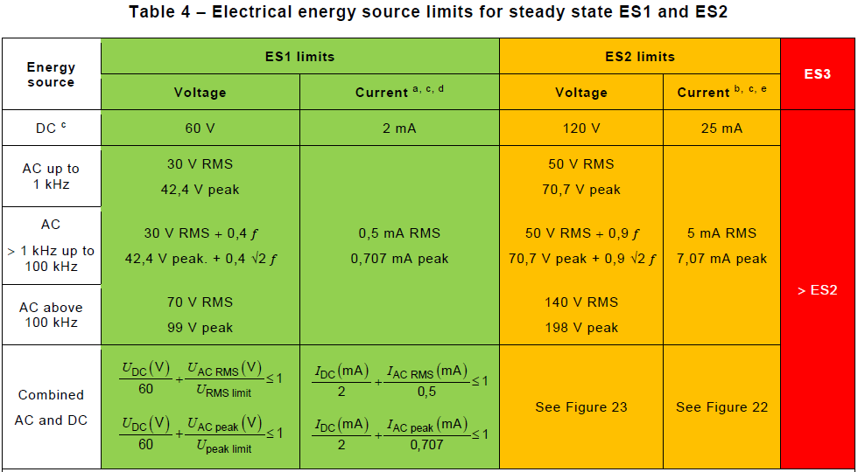

5) Backfeed safeguard in battery backed up supplies

Slide 73
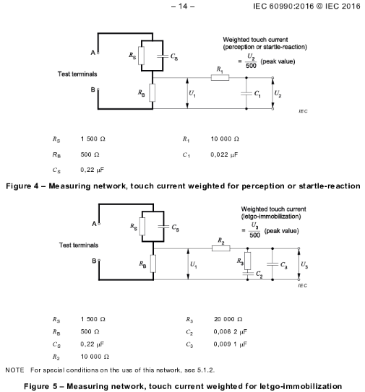
5) Backfeed safeguard in battery backed up supplies

Slide 74
5) Backfeed safeguard in battery backed up supplies
Definitions
3.3.6.2
backfeed
condition in which a voltage or energy available within a battery backed up supply is fed back to any of the input terminals, either directly or by a leakage path while operating in the stored energy mode and with mains power not available
3.3.11.1
backfeed safeguard
control scheme that reduces the risk of electric shock due to backfeed

Slide 75
5) Backfeed safeguard in battery backed up supplies
Equipment:
Check the calibration records (as applicable to demonstration):
Ambient Temperature Indicator ( +/- 2 degree C )
Ambient Humidity Meter ( +/- 6% )
Digital Multimeter ( Voltage up to 1000 V, up to 1 kHz: ± 1.5%; Current less than 5 A, dc to 60 Hz: ± 1.5% )
Simpson 228 Leakage Current Meter (if used) meeting IEC 60990:2016, Figures 4 and 5 ( See next three slides )
Voltage Probe to Oscilloscope – Verify high impedance probe used ( 100 MΩ ± 5 MΩ ) (If calibrated as part of Oscilloscope, Voltage up to 1000 V, up to 1 kHz: ± 1.5%) (If calibrated stand-alone, see Slides 83 and 84)
Oscilloscope ( Voltage up to 1000 V, up to 1 kHz: ± 1.5% )
Power Supply ( Voltage up to 1000 V, up to 1 kHz: ± 1.5%; Frequency: ± 0.2% )
Timer ( Seconds, ± 1% )
B. Check calibration or validation records:
Stand-alone Measuring Networks (if used) meeting IEC 60990:2016, Figures 4 and 5 ( See next three Slides )

Slide 76

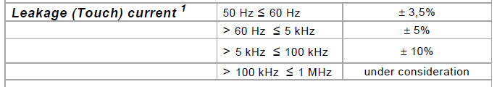
5) Backfeed safeguard in battery backed up supplies
Calibration meeting IEC 60990:2016, Figures 4 and 5:
Example reference calibration certificate:
For Figure 4 (startle-reaction) and Figure 5 (letgo-immobilization), check input current in MIU:
Note: 1 MIU = 1 mA

Slide 77
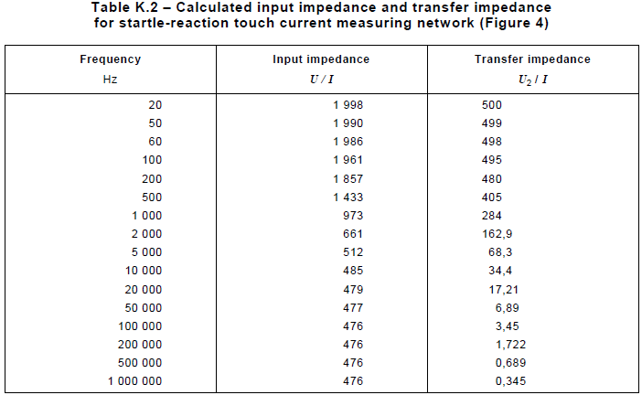
5) Backfeed safeguard in battery backed up supplies
Calibration meeting IEC 60990:2016, Figures 4 and 5 (cont.):
Additionally, for Figure 4 (startle-reaction) and Figure 5 (letgo-immobilization), check input impedance and transfer impedance per Table K.2 and Table K.3 respectively:

Slide 78
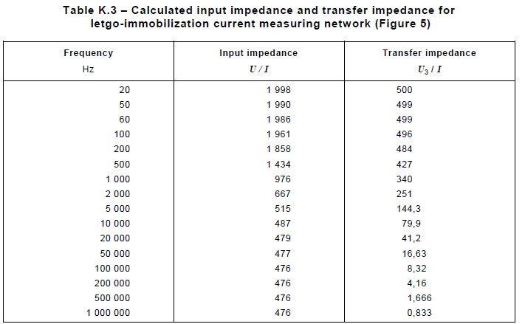
5) Backfeed safeguard in battery backed up supplies
Calibration meeting IEC 60990:2016, Figures 4 and 5 (cont.):

Slide 79
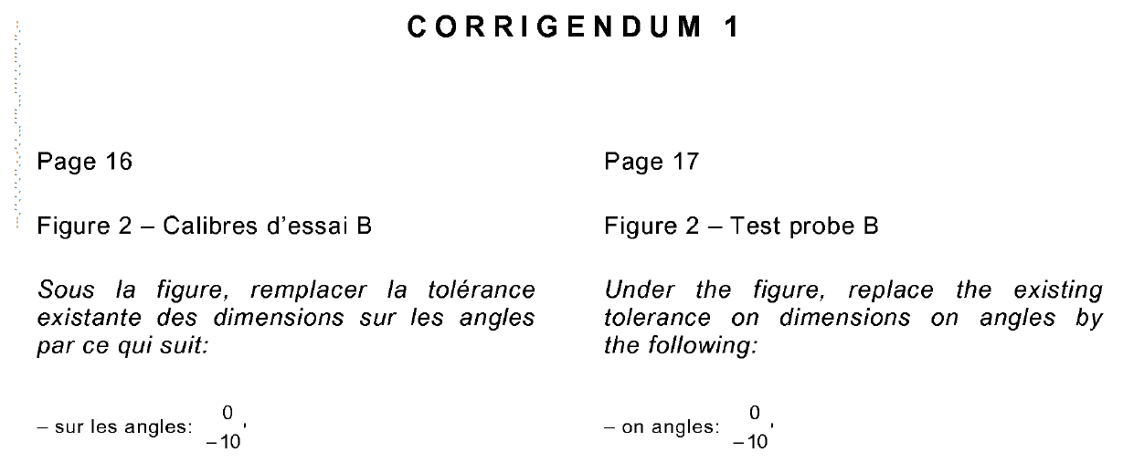
6) Calibration Certificates - Test Probe
IEC 62841-1:2014 references IEC 61032:1997 which was amended with Corrigendum 1:2013. This corrigendum corrected tolerances on angles to 0/-10’ for Test Probe B on Figure 2 (replacing original 0/-10°text). We need to look at Calibration Certificates for these probes and validate that angles are calibrated with tolerance of 0/-10’. (Note: The same probe used for MED and ITAV have different specification and tolerances provided in the respective standards with informative reference to IEC 61032:2007.)

Slide 80
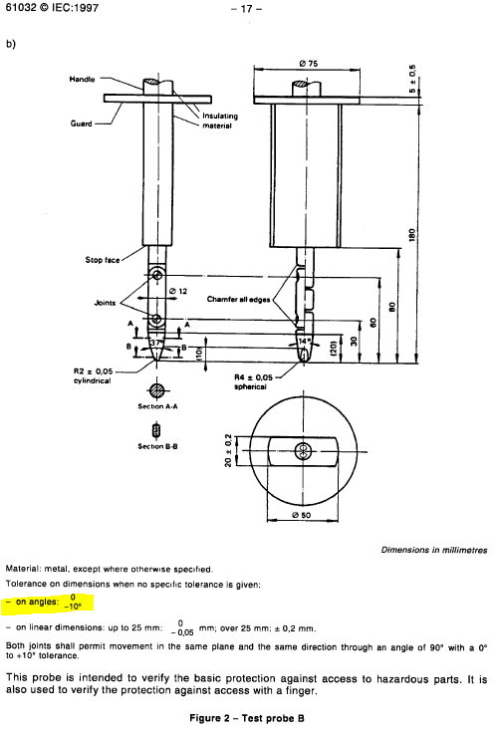
6) Calibration Certificates - Test Probe

Slide 81
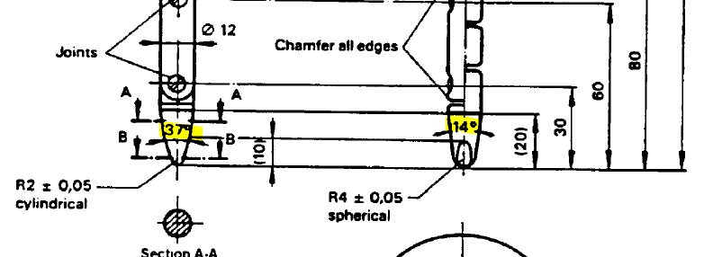
6) Calibration Certificates - Test Probe

Slide 82
6) Calibration Certificates - Test Probe
Additional Notes:
Angular dimensions can be expressed in both decimal degrees (e.g., 30.86°) or in degrees, minutes, seconds (e.g., 30°51' 36")
1°= 60’ = 3600”
For this particular case, tolerance -10’ is equivalent to -0.1666667°
****
As further explanation for the 0/-10’ angle tolerance, “0” indicates that no positive angle deviation from nominal are allowed (i.e., the angle can be no bigger than exactly the specified14° or 37°), but an angle up to 10’ less than nominal is allowed.

Slide 83
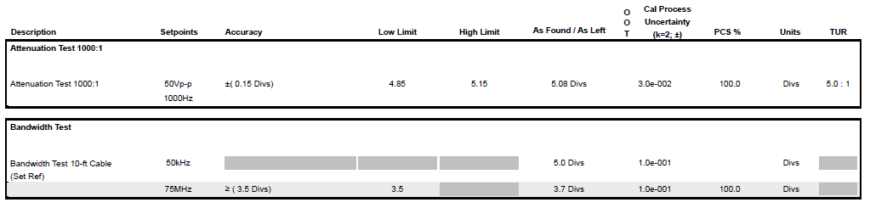
7) Calibration Certificates – Stand-alone High Voltage Oscilloscope Probes
For stand-alone High Voltage Oscilloscope Probes (not calibrated as part of an oscilloscope), the calibration of the voltage output performance shall be checked.
Here is an example of what to look for on the certificate:

Slide 84
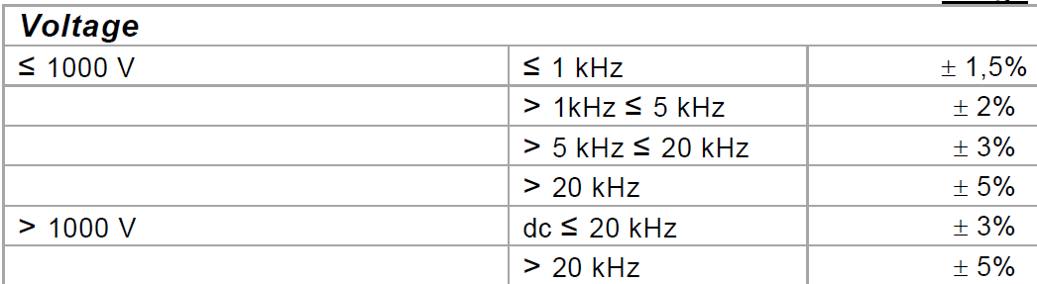
7) Calibration Certificates – Stand-alone High Voltage Oscilloscope Probes
Additional Notes:
The default voltage accuracies per OD-5014 are as follows:
Note - Do not check those frequencies > 100 kHz, as these are based on manufacturer’s specifications (no specified limit).

Slide 85
7) Calibration Certificates – Stand-alone High Voltage Oscilloscope Probes
Additional Notes:
Probe attenuation is the amount by which a probe reduces signal amplitude. For example, a probe can attenuate a high voltage measurement input into a low voltage output (safe for an oscilloscope).
This can be expressed by the attenuation ratio. For example, a 100:1 ratio means that a measurement input of 100V will be attenuated to 1 V on the probe output.
Attenuation factor is another way to express this. Typical attenuation factors
are 1X, 10X, and 100X. These are equivalent to attenuation ratios of 1:1, 10:1 and 100:1 respectively.

Slide 86
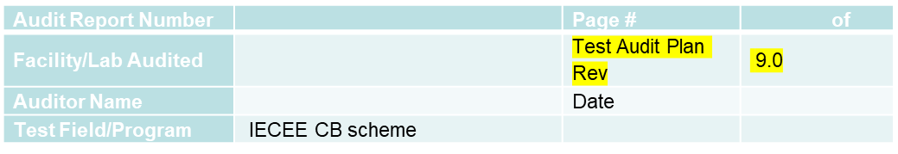

Records of Audit
00-QA-F0407, V4.0 is used to record the audit results.

Slide 87
Revision History
1.0 Initial Release

